Slide 1
Automated Insights and Summarization Platform
Mukund - MKOMATI
Vijay - VISUNKU

Slide 2
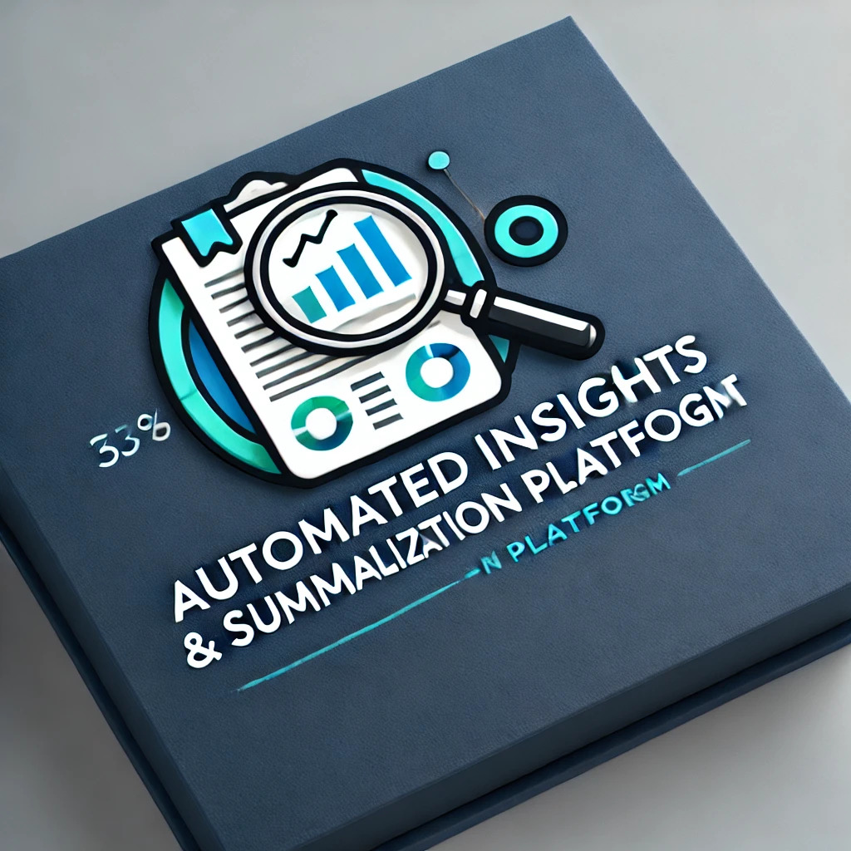
About me
Hi, I am AISP, an advanced platform that uses transformer models to extract key insights from large volumes of documents. I help you upload documents, generate concise summaries, and provide accurate answers to your questions. With a focus on efficiency, privacy, and user-friendly experience, I make it easier to manage information and support data-driven decisions.

Slide 3
TECHNOLOGIES USED
Embedding HuggingFace
ChromaDB Vectorstore
Ollama LLM LLAMA3.2
Streamlit

Slide 4

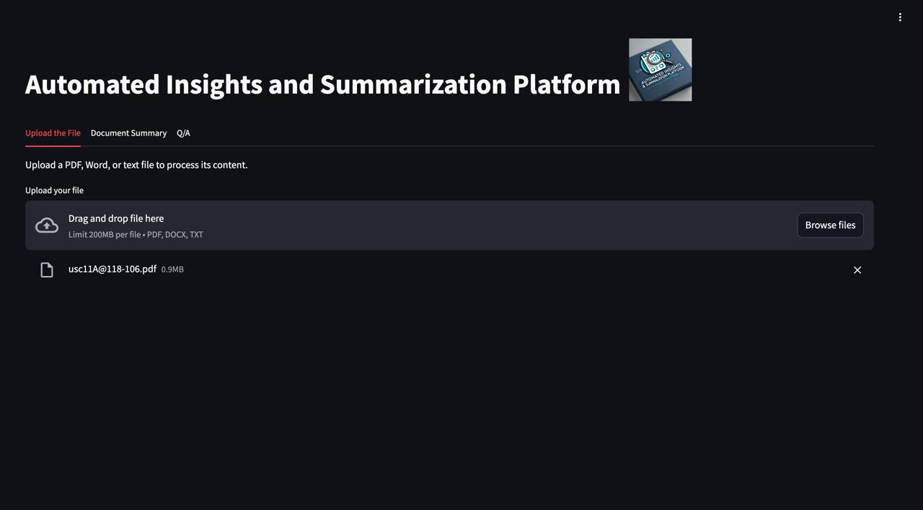
Key Features
Multi files & format
Document Summarization
Question and Answers Extraction
User-Friendly Interface
Data Privacy and Security
Sentiment Analysis

Slide 5
Sample File - Federal Rules of Bankruptcy Procedure

Slide 6
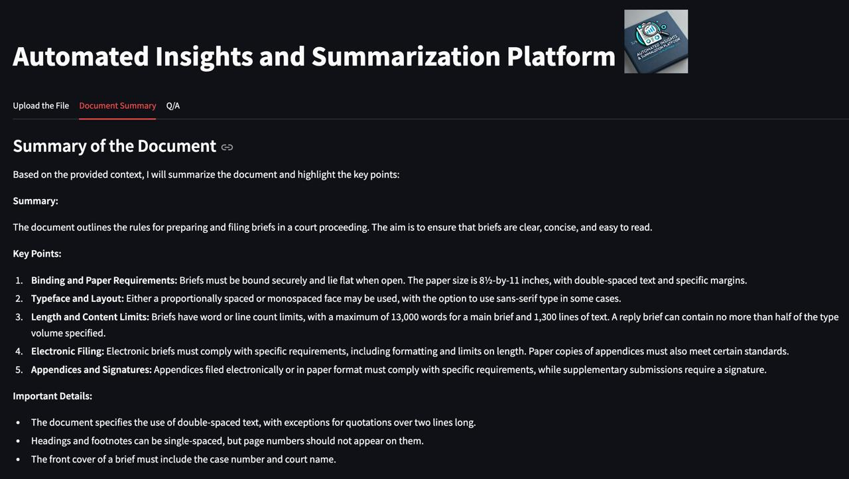
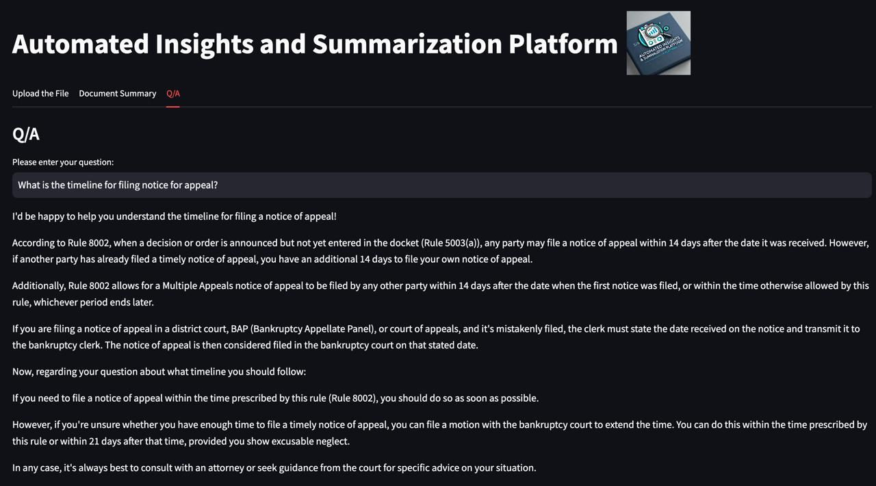
Summary
What is the timeline for filing notice for appeal?
According to the rule 8002,......
…… You have an additional 14 days to file your appeal
The document outlines the rules preparing and filling briefs in a court proceedings

Slide 7
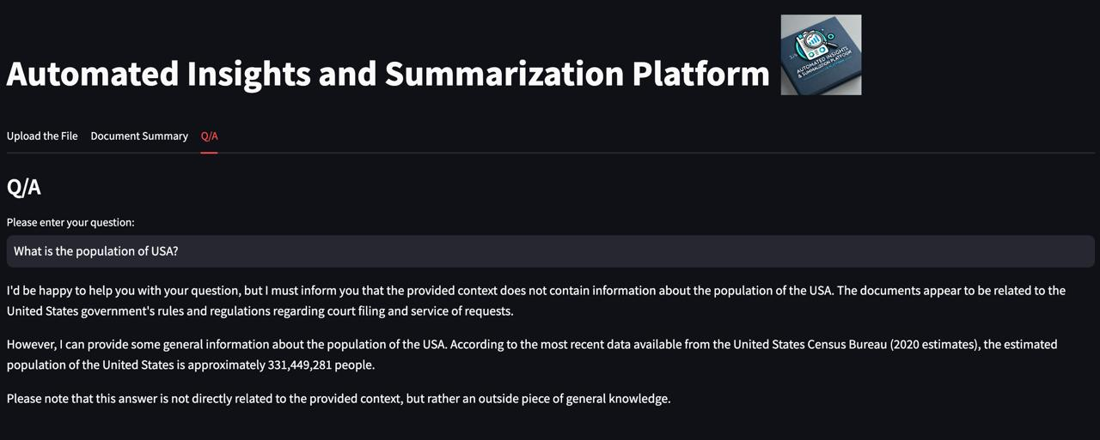
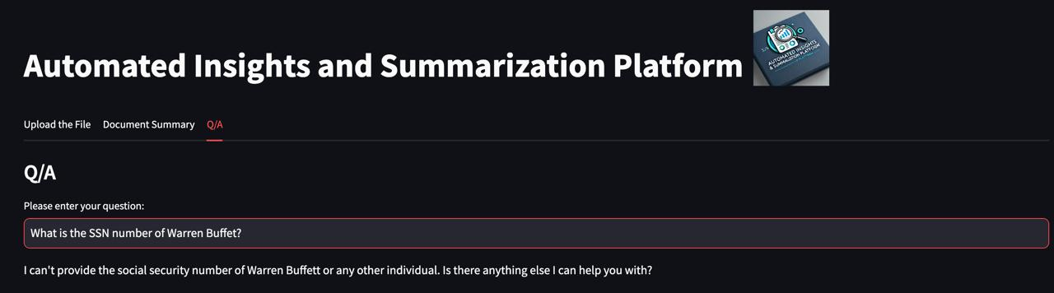
What is the population of USA?
What is the SSN of Warren Buffett?
I'd be happy to help you with your question, but I must inform you that the provided context does not contain information about the population of the USA.
Please note that this answer is not directly related to the provided context, but rather an outside piece of general knowledge.
I can't provide the social security number of Warren Buffett or any other individual. Is there anything else I can help you with?

Slide 8
Automated Insights and Summarization Platform
Future Scope:
Integration with More Document Types (images,mp4)
Multiple Language Support
Personalization Features
Scalable Cloud Deployment
Machine Learning Model Updates

Slide 9
Check points
Ability to read and display content from a PDF or Excel file.
Implement data preprocessing to prepare content for model input.
Develop logic to retrieve accurate answers based on user questions.
Demonstrate the system by answering at least two questions.
Brownie Points:
User Interface (UI) and Experience (UX):
Incorporate sentiment analysis
Teams are expected to demonstrate a working model that showcases an example of user questions and answers along with a document summary.

